Slide 1

WEB SCRAPING TO GAIN COMPANY INSIGHTS
By: AMEEN MAGOBON ABDULFATAI
10/2/2023

Slide 2
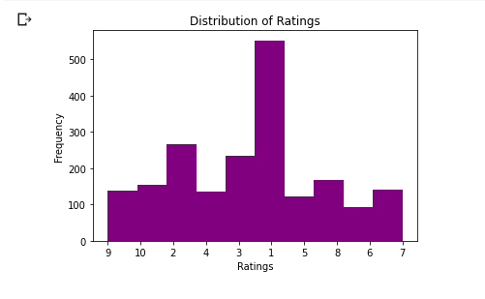
IRatings Distribution

Slide 3
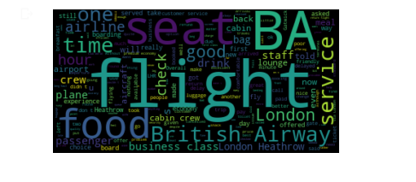
Wordcloud

Slide 4
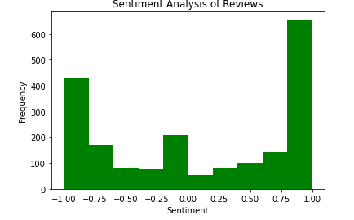
Sentiment Analysis of Reviews

Slide 5
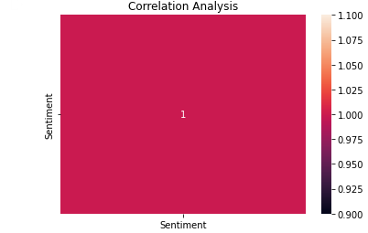
Correlation

